Slide 1
DevSecOps & Automation – EP&S Monthly Report Out - January 2024

Slide 2
CONTENTS
Vision
2024 OKR and Focus Areas
DSO Status per director
Technical Sessions
Automation Progress
Training and references

Slide 3
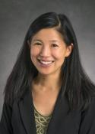



Vision
Implement Lean practices through DSO maturity coverage and IT Automation.
Increased operating speed and flexibility, release-on-demand, and first-time quality of secure-by-design applications.
Reduced hours and improved efficiency through automation

Slide 4




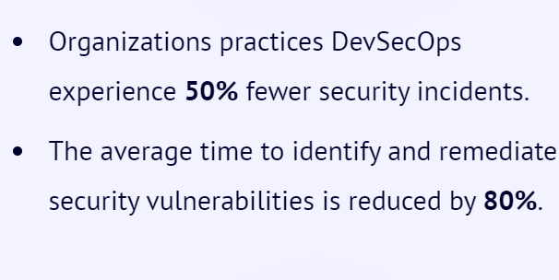
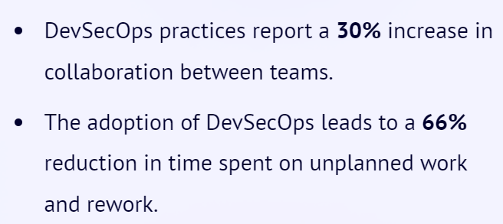
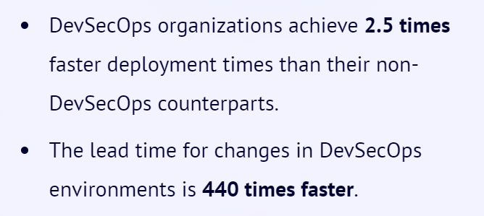
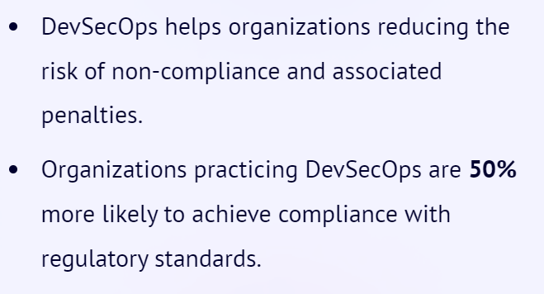
Why Implement DevSecOps?
Improved Security
Collaboration
Time to Market
Compliance
Notes:
Source:1) DevSecOps Community Survey
2) Puppet State of DevOps Report (https://www.puppet.com/resources/state-of-devops-report)

Slide 5
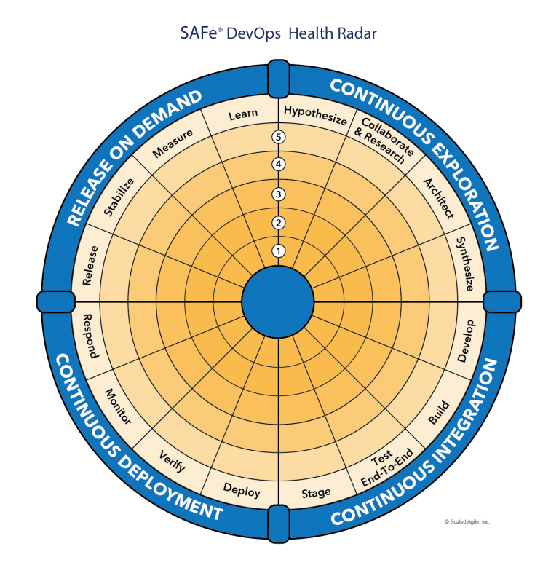
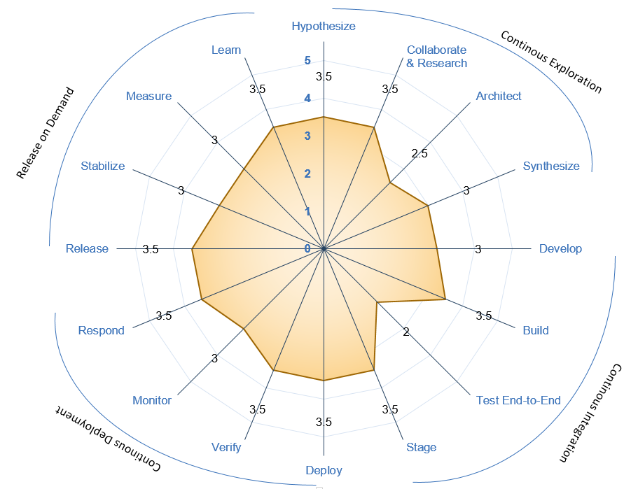





Understanding DevSecOps Maturity
Maturity Level | Stage | Stage Adoption | % of Adoption
Level 1 (Sit) | Initial | Yet to Start; Traditional environment and mindset | <=20%
Level 2 (Crawl) | Emerging | Beginning of change and agility; Initiated automation; | 21%-50%
Level 3 (Walk) | Practicing | Started Practicing; Transformation happening with defined process and automation | 51%-70%
Level 4 (Run) | Optimizing | High in Adoption ;Optimizing the existing practices and following Continuous improvement | 71%-90%
Level 5 (Fly) | Leading | Being a leader in adoption; | >90%
Recommended minimal level for DSO Adoption
Maturity Level
Sit
Level 1
Crawl
Level 2
Walk
Level 3
Run
Level 4
Fly
Level 5
1- Low & 5-High Maturity

Slide 6
Assessment Process
DevSecOps Assessment Process Flow (Swimlane)
Please refer to the attached PDF.
GSEP Process for Dashboard Access
Please use the link to get access to the assessment dashboard. This is an auto approval process. Please select the first option for Business Stakeholder group.
Try to access this Dashboard Link after few minutes.

Slide 7
2024 OKR AND FOCUS AREAS

Slide 8
DevSecOps
1- Improve maturity for business critical applications
to Level 3 (minimum).- focus on 10% of applications (50) that have completed Assessment.
2- Focus on DevSecOps maturity for apps already in cloud or plan to move in 2024
2- Complete assessment for product with highest ROI - 20% Remaining Apps.
3- Build Reusable libraries from learnings and success stories
4- Training and Upskilling sessions for team ( 3 per Quarter)
5- Pilot projects with Software chapter team to improve maturity
High ROI products for focus:
Jennifer
Regulatory and Safety
Tatum
System Engineering
Electrical Engineering
Customer Engineering (CE)
Buba
Digital Market Products
Technical Publications
Jeff
Embedded Program Support
Product Support Analysis
Automation
1- Improve Automation efficiency high ROI Products and bring product efficiencies.
2- Overall savings of 140K Hrs (35K/Per Director)
3- Build Lean practices and automation for Compliance , TechDebt and Compute

Slide 9
Director | Products | # Applications | Total assessments Completed | Product Maturity Level | 2023 |  |  | 2024 Target
 |  |  |  |  | Assessments Complete | Re-assesments Complete | Automation Savings | Assessments | Reassessments | Automation Savings
Jennifer | Summary | 173 | 39 |  | 16 | 5 | 83007 | 27 | 6 | 35000
 | Regulatory and Safety | 26 | 12 | 3.3 | 4 | 1 |  | 3 | 2
 | Research and Technology | 10 | 9 | 3.3 | 5 | 2 |  |  | 1
 | Test and Evaluation | 48 | 14 | 2.9 | 4 | 2 |  | 7 | 2
 | Non DTPLM | 89 | 4 | 2.6 | 3 | 0 |  | 17 | 1
Tatum | Summary | 425 | 149 |  | 80 | 17 | 23160 | 56 | 22 | 35000
 | Authoring Process Planning | 21 | 16 | 3.5 | 10 | 4 |  | 1 | 2
 | Data Distribution and Management | 60 | 19 | 2.9 | 1 | 0 |  | 8 | 3
 | Automation Programming | 24 | 4 | 3.2 | 0 | 0 |  | 4 | 1
 | Customer Engineering (CE) | 9 | 0 | NA | 0 | 0 |  | 2 | 0
 | DT PLM | 17 | 14 | 3 | 7 | 6 |  | 1 | 2
 | Electrical Engineering | 63 | 6 | 3.4 | 0 | 0 |  | 11 | 1
 | Flight Engineering and Propulsion | 132 | 62 | 1.9 | 60 | 0 |  | 14 | 9
 | Mechanical and Structural Engineering | 46 | 6 | 2.9 | 1 | 0 |  | 8 | 1
 | Systems Engineering | 33 | 5 | 3.7 | 0 | 1 |  | 6 | 1
 | Production System Simulation | 1 | 1 | 2.5 | 1 | 0 |  | 0 | 0
 | Visualization and xR | 19 | 16 | 3 | 1 | 6 |  | 1 | 2
Buba | Summary | 166 | 70 |  | 19 | 7 | 65343 | 20 | 10 | 35000
 | Digital Market Products | 54 | 22 | 3.6 | 5 | 1 |  | 6 | 3
 | Customer Operations | 24 | 16 | 3.1 | 2 | 1 |  | 2 | 2
 | Technical Publications | 59 | 23 | 3.1 | 8 | 5 |  | 7 | 4
 | Training & Other | 35 | 9 | 3.1 | 4 | 0 |  | 5 | 1
Jeff | Summary | 187 | 76 |  | 14 | 3 | 12760 | 27 | 12 | 35000
 | Automation Programming | 26 | 26 | 3.2 |  |  |  |  | 4
 | Innovation Hub |  |  | NA
 | Material Management | 18 | 9 | 3.7 | 0 | 0 |  | 2 | 1
 | Maintenance Repair and Overhaul | 24 | 12 | 3.1 | 1 | 1 |  | 2 | 2
 | Integrated Logistics Planning and Management | 35 | 11 | 3.4 | 1 | 0 |  | 5 | 2
 | Product Support Analysis | 32 | 7 | 3.5 | 4 | 0 |  | 5 | 1
 | Embedded Program Support | 78 | 11 | 3.3 | 8 | 2 |  | 13 | 2
E&PS Summary |  | 982 | 334 |  | 130 | 32 | 184270 | 131 | 50 | 140000 Hrs

Slide 10
Bringing efficiency at product
Product Efficiency
Compliance
Tech Debt
Compute
DevSecOps & Automation
Application Roadmap
/retirement
Cloud
Look ahead
Work with DRI support across areas to identify opportunities of automations

Slide 11
Strategy & improvements
Opportunity for technical leaders and Product/Project managers to be part Initiative.
Continue collaboration with EA Team for governance and improvements at IT&DA
DevSecOps & Automation
Governance & Collaboration
Product Centricity
Rewards
Training & upskilling
Communication
Communication to all employees on progress and importance Initiative.
Establish OKR at products
Product manager to drive higher maturity for applications and Track status in QBR
Focal to be assigned and collaborate with Product leaders to help on product maturity improvements
Resources and sessions for all employees.
Focused trainings for focal.
Hands-on experience to focal for their development and growth
Rewards for products & application team
Rewards for Core team

Slide 12
Progress
On Track
Watch Item
Off Track
Q1
2024 OKR Targets
Target
Completed
Complete DSO Assessments for new applications 131 Apps
30
01
Implementation roadmap for Applications that have completed assessments- 90 Apps
30
01
Roadmap implementation , Re-Assessment & ROI calculation for 15% Apps with roadmap created: - 50 apps
10
01
*DSO Improvements pending
Maturity improvement and maintain Score 3.0+
Maturity Score 3.95

Slide 13
DSO STATUS PER DIRECTOR( till Jan 2024)

Slide 14
Engineering Products(Jennifer)
On Track
Watch Item
Off Track
18
** Reassessment target for 2024 – 6

Slide 15
Engineering Products (Tatum)
On Track
Watch Item
Off Track
**Reassessment target for 2024 – 22

Slide 16
Engineering Products (Buba)
On Track
Watch Item
Off Track
8
**Reassessment target for 2024 – 10

Slide 17
Engineering Products (Jeff)
On Track
Watch Item
Off Track
13
**Reassessment target for 2024 – 12

Slide 18
Technical sessions
TBD

Slide 19
AUTOMATION PROGRESS

Slide 20




Automation 2024
Implement automation capabilities through out the applications and achieve 80000 automation hours
OKR
Objective
Accomplishments:
Automate repetitive processes
Automation hours of 184270 has been accounted in the CoP.
Capture automation to Return On Investment.
Knowledge sharing and bring culture of Automation

Slide 21
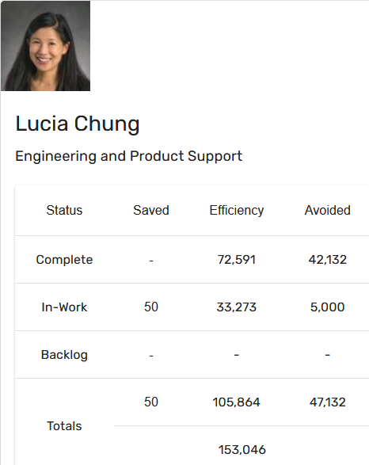
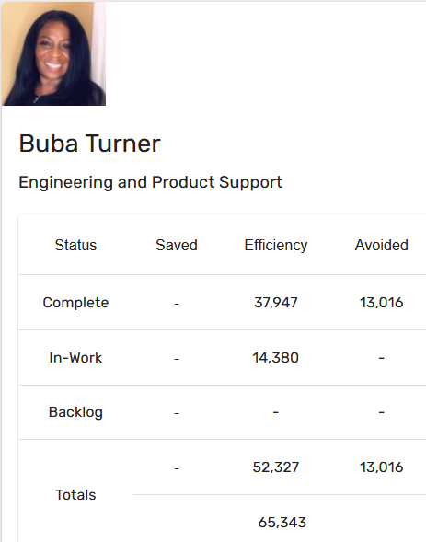
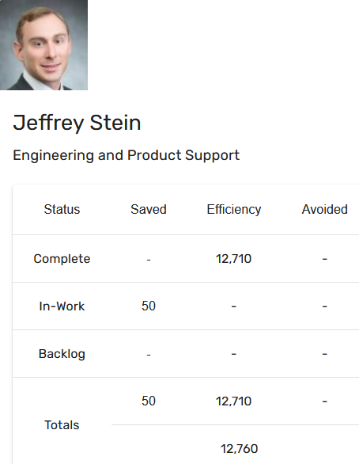
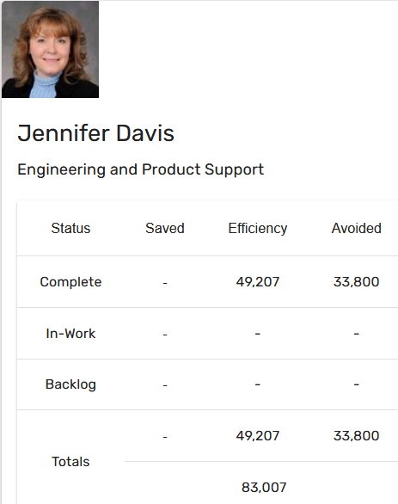
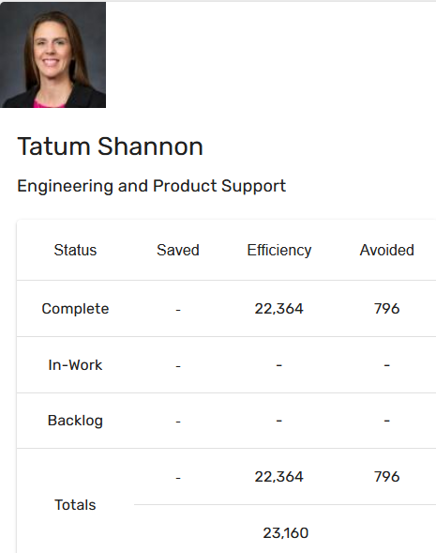
Automation Status - 2023
Target: 80k hrs
Current status: 184k hrs
Total : 184270 hours

Slide 22
Training and references

Slide 23
Training and support
Automation COP
https://devsecops.web.boeing.com/index.html [DevSecOps Enterprise Website]
Training:
https://devsecops.web.boeing.com/trainings.html
https://insite.web.boeing.com/culture/viewMedia.do?mediaId=428840
Insite: DevSecOps related video series
Degreed: https://degreed.com/pathway/mpl66o5r9d/pathway
Oreilly: https://learning.oreilly.com/library/view/the-devops-handbook/9781457191381/
Enterprise Support
In case of any queries interested teams can register themselves through EMC (check for the session with the name “DevSecOps Office Hours (India)”).
For Product Teams in US, Click Here to block your slot
For Product Teams in India, Click Here to block your slot
DSO Support Systems | Description | URL
ATOMS | Platform to onboard to some of the commonly used tools like Coverity, Netsparker, SonarQube | https://atoms.web.boeing.com/home
ATOMS-CI | Saves your team time by generating an automated continuous integration pipeline and integrating different tools | https://atoms-ci.web.boeing.com/ci
DevSecOps | Official DevSecOps website | https://devsecops.web.boeing.com/index.html
AppDynamics | Monitoring tool documentation | https://itms.pages.boeing.com/wiki/appdynamics/
Enablement kit | Architecture Checklist to improve maturity | https://devsecops.web.boeing.com/assessment/enablementKit.html
DSO Mattermost channel | Join this channel for any questions/updates | https://mattermost.web.boeing.com/dso/channels/town-square
DSO Consultation | Connect with the experts | DL DSO Consulting
DSO COE InSite Group | Join this group for any questions/updates | https://insite.web.boeing.com/culture/viewGroup.do?groupId=168061
DevSecOps Video Library | Videos on different implementation | https://insite.web.boeing.com/culture/displayGroupMedia.do?groupId=168061

Slide 24
Assessment Process
DevSecOps Assessment Process Flow (Swimlane)
Please refer to the attached PDF.
GSEP Process for Dashboard Access
Please use the link to get access to the assessment dashboard. This is an auto approval process. Please select the first option for Business Stakeholder group.
Try to access this Dashboard Link after few minutes.
Info center Dashboard Link
Refer attached excel for pending reassessments and assessments.

Slide 25
Contact us
 | DRI | Project Management | Core Team Focal | Enterprise collaboration
DevSecOps | Abhishek Singh Kenneth C Shew | Kolhar Laxmidevi Kumar Anand | Singh, Abhishek K Valiyarayil, Siby Nair, Aathira Manikandan P, Ashwini Pattanaik, Anup K Ammata, Sudhakar Bakhedi, Bharati Bahubali Balraj, Bharath K Ghosh, Saikat Ghosh, Subhabrata Gundupalli, Rajesh Reddy H D, Sarika K L, Bharath Karri, Ram Sai K-R, Rahul Kuriakose, Tintu M Kurian, Abhijith Kuruba Chandra Kumar Mistry, Ashok Nagaraju, Ganesh Nagziriya, Anshika Padmanaban Shunmugam, Nihila Abhishek Kumar Prabhat, Kumar Radhakrishnan, Chinjumol Reddy, V Sanjeev Rompicherla, Rakesh Sawant, Swapnil Ravindra Varghese, Jessy Vinukonda, Basha Jayanta Mondal DL Product Systems - DevSecOps Core Team | Karthik Tirukkoylur Sekhar Dolly Bhaskara Arun Prakash Jeyaprakash Anandapadmanabhan Gopalakrishnan Sushil Mishra Donald R Wellington DL DSO DRIs
Automation | Kenneth C Shew Naga Harsha Kaggallu | Priyanka Dhanpal Chougule

Slide 26
Thank You

